Slide 1
BADMINTON SERVER VER 1.0
USER GUIDE

Slide 2
Version | Date | Edited By | Description
1.0.01 | 04-06-2020 | Megha M | Initial Release(Draft copy)

Slide 3
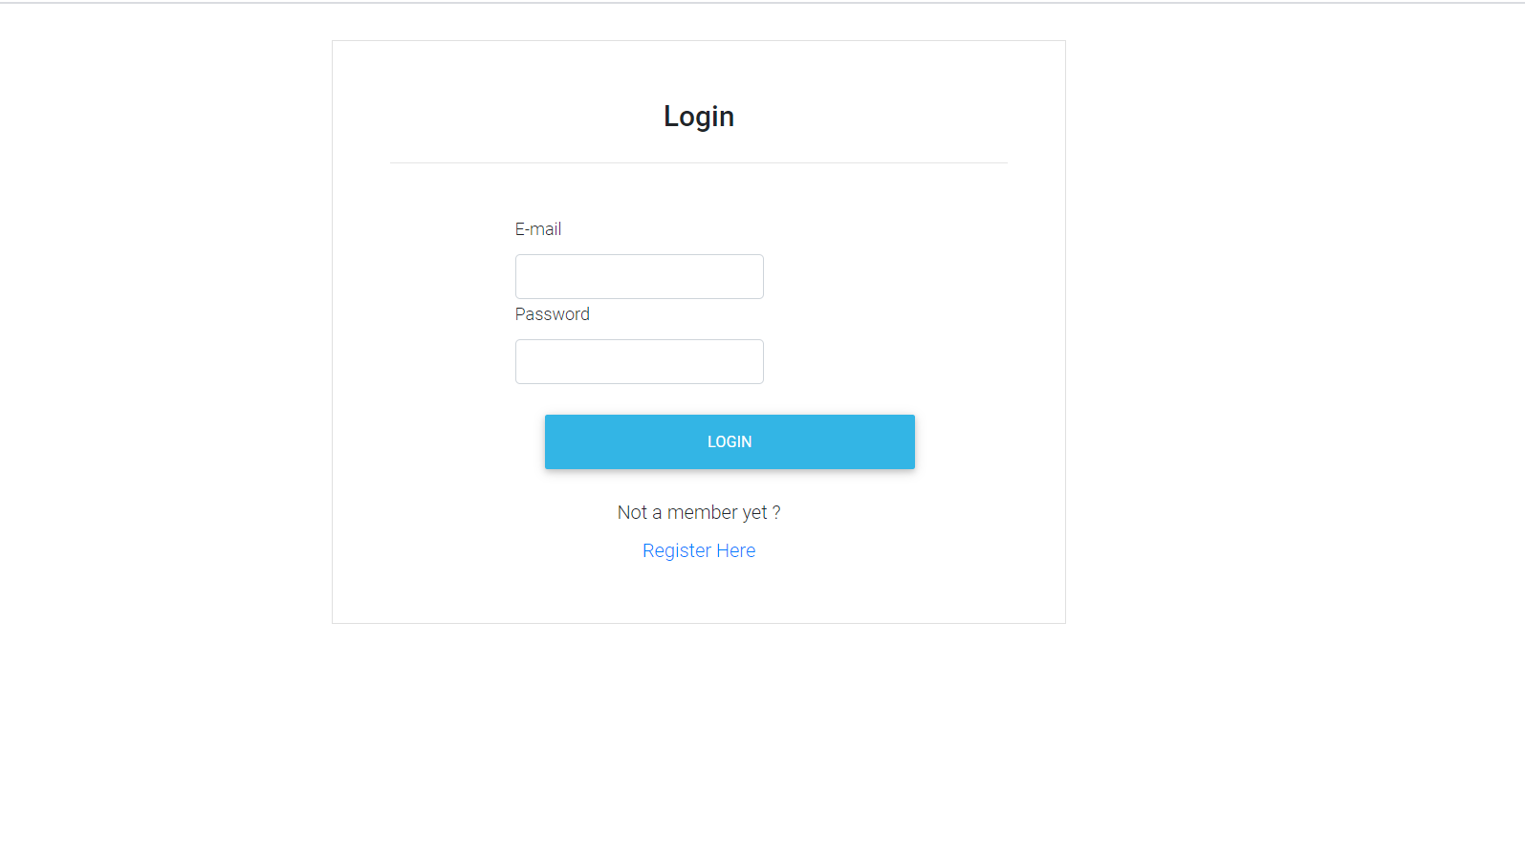
Admin Login:
Enter the registered mail Id and password.

Slide 4
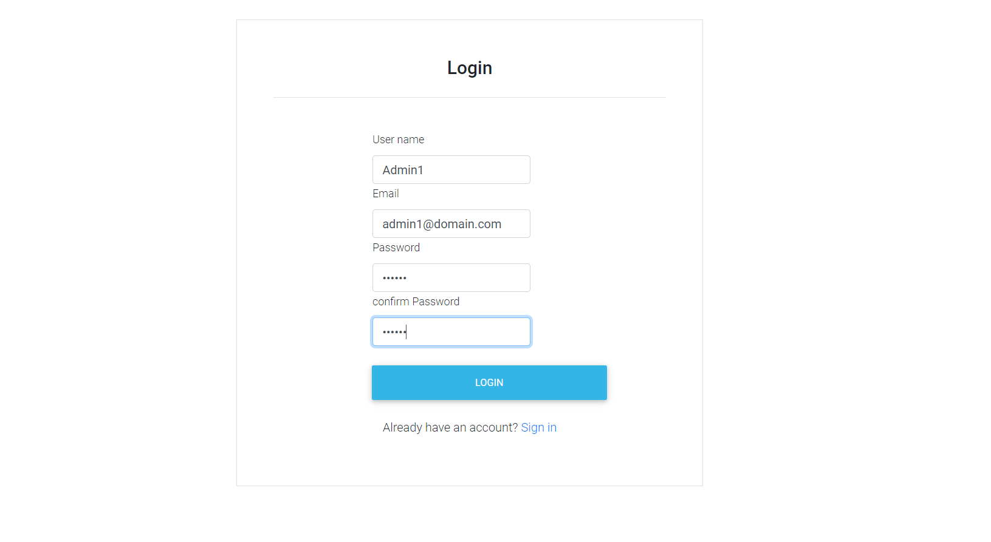


Admin Register:
Enter the required fields.

Slide 5
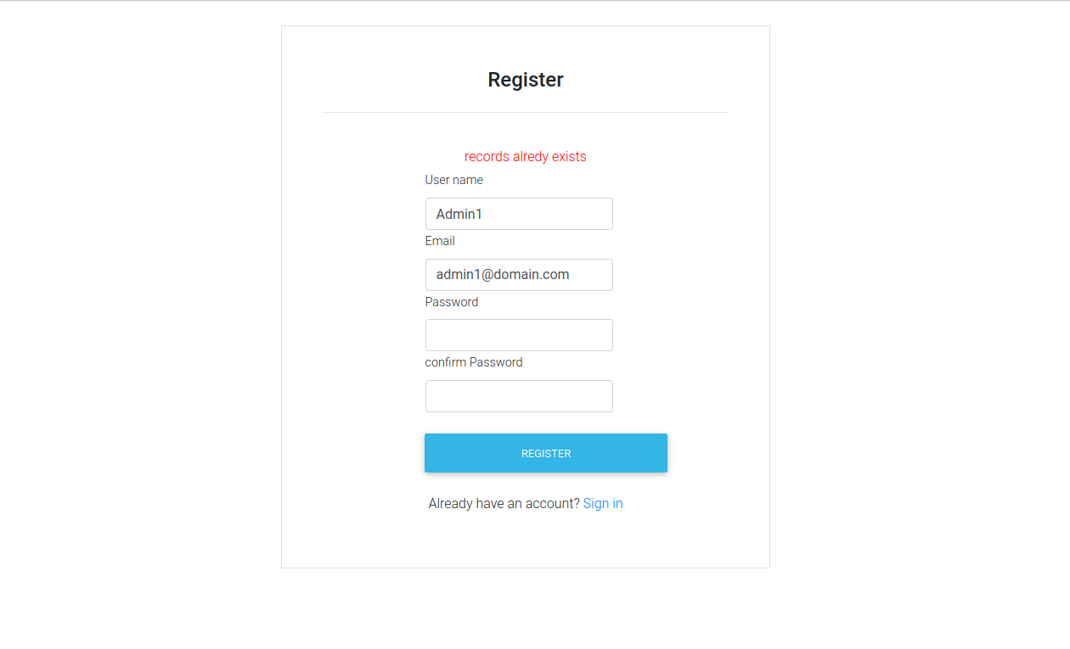
Admin Register failure:
Registration is failed when the same mail id is entered which is already registered.

Slide 6
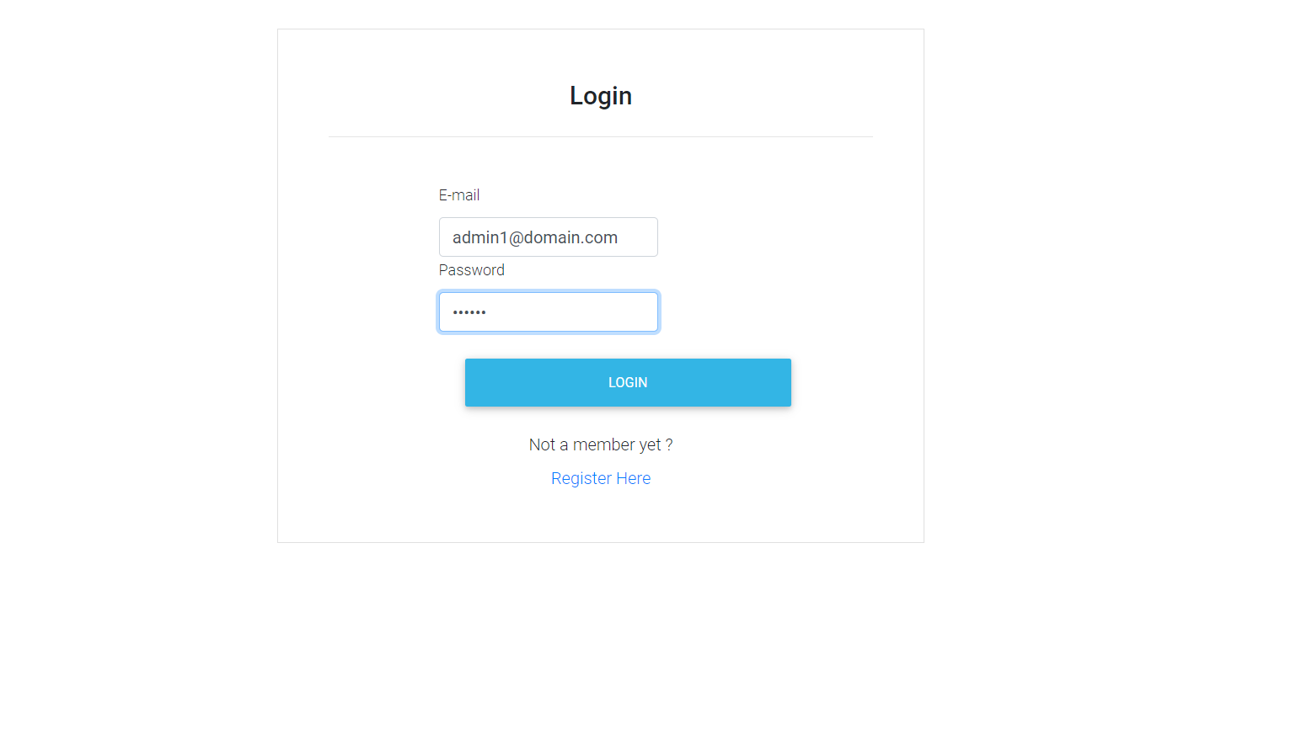
After successful registration, redirects to Login.
Enter the registered mail Id and password.

Slide 7
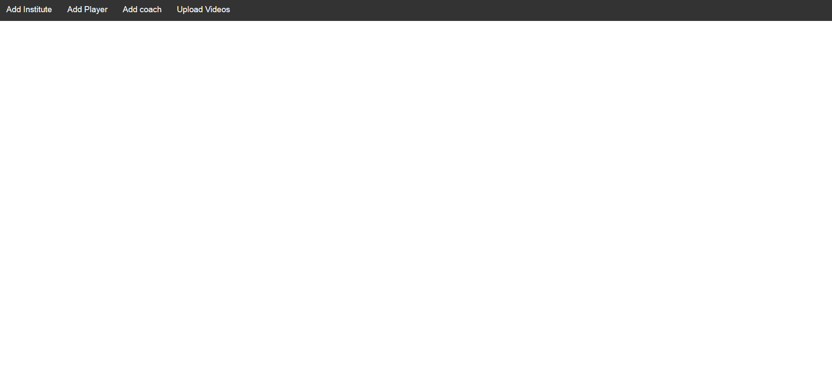


After successful Login.

Slide 8
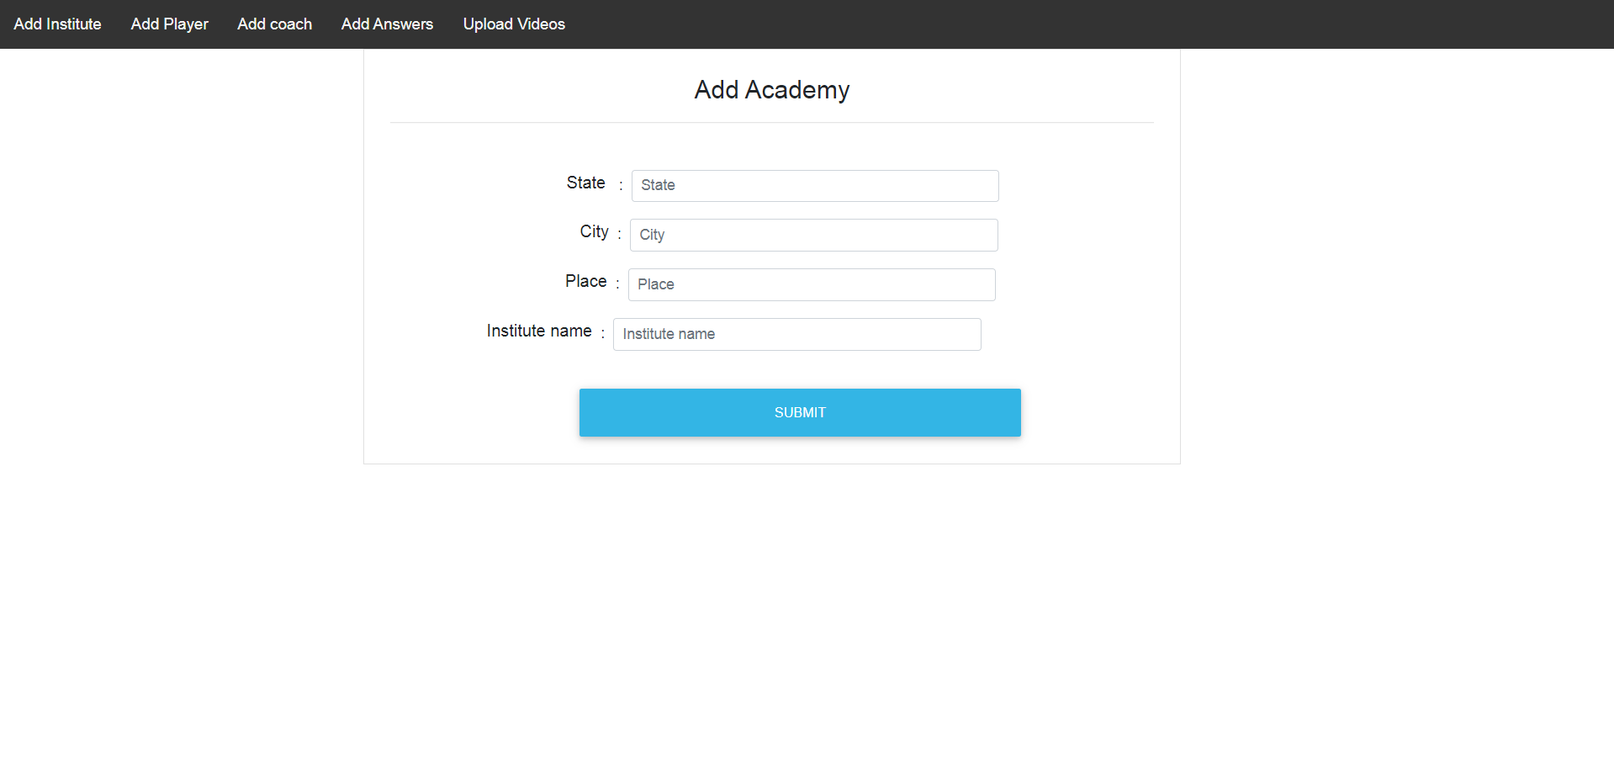

Add Institute page to add new institute.

Slide 9
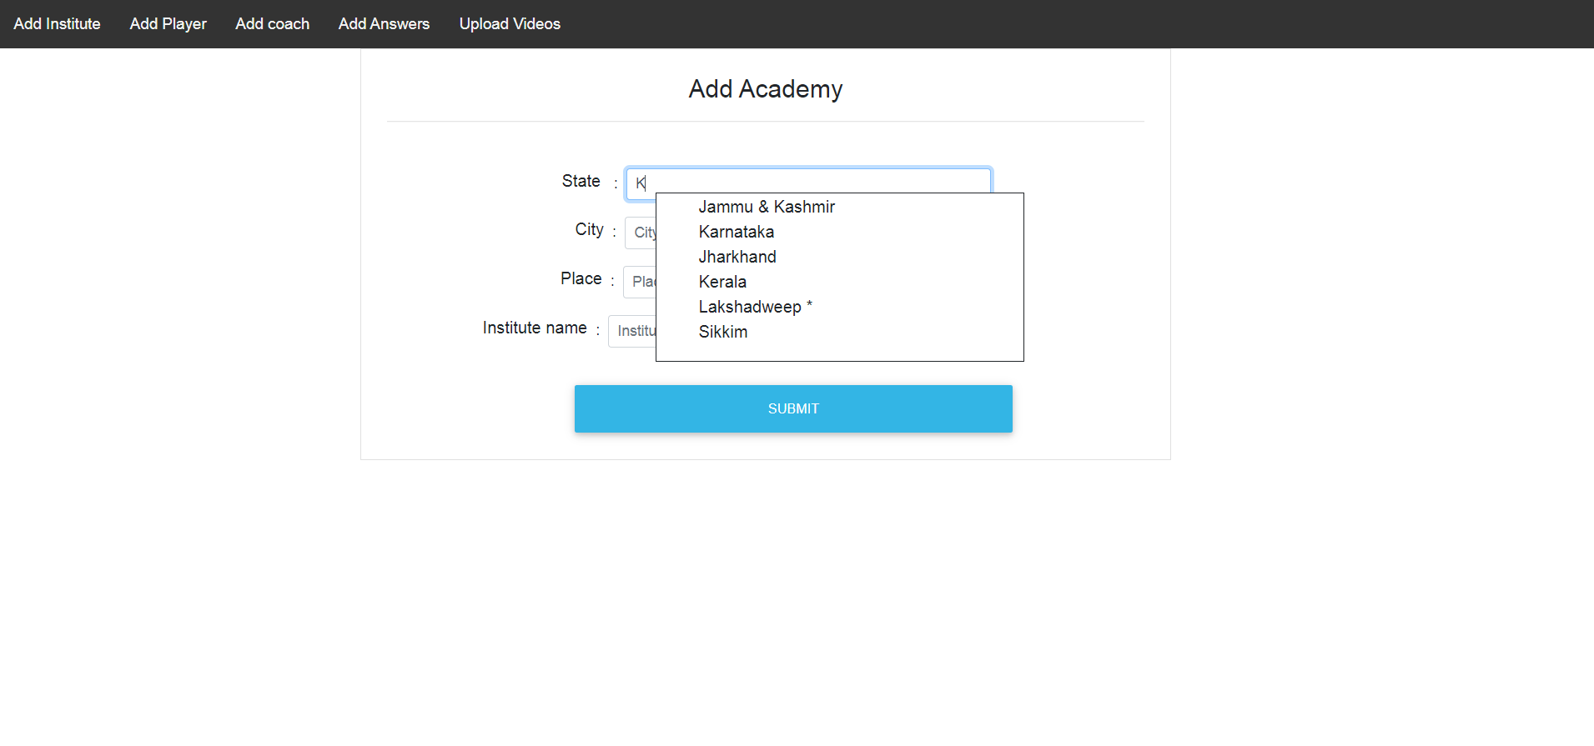
Select the state.

Slide 10
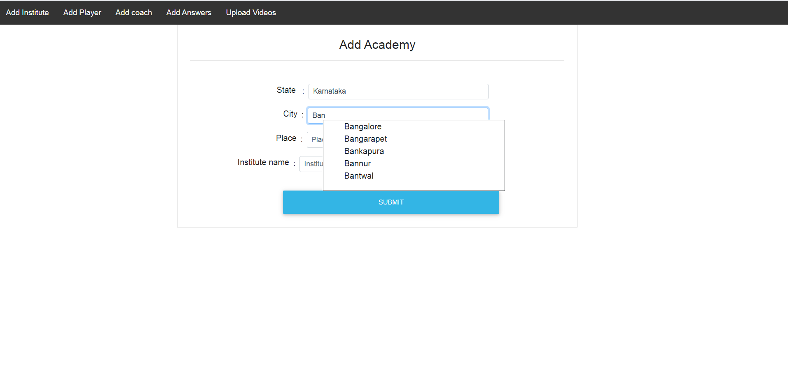
Select the city associated with state.

Slide 11
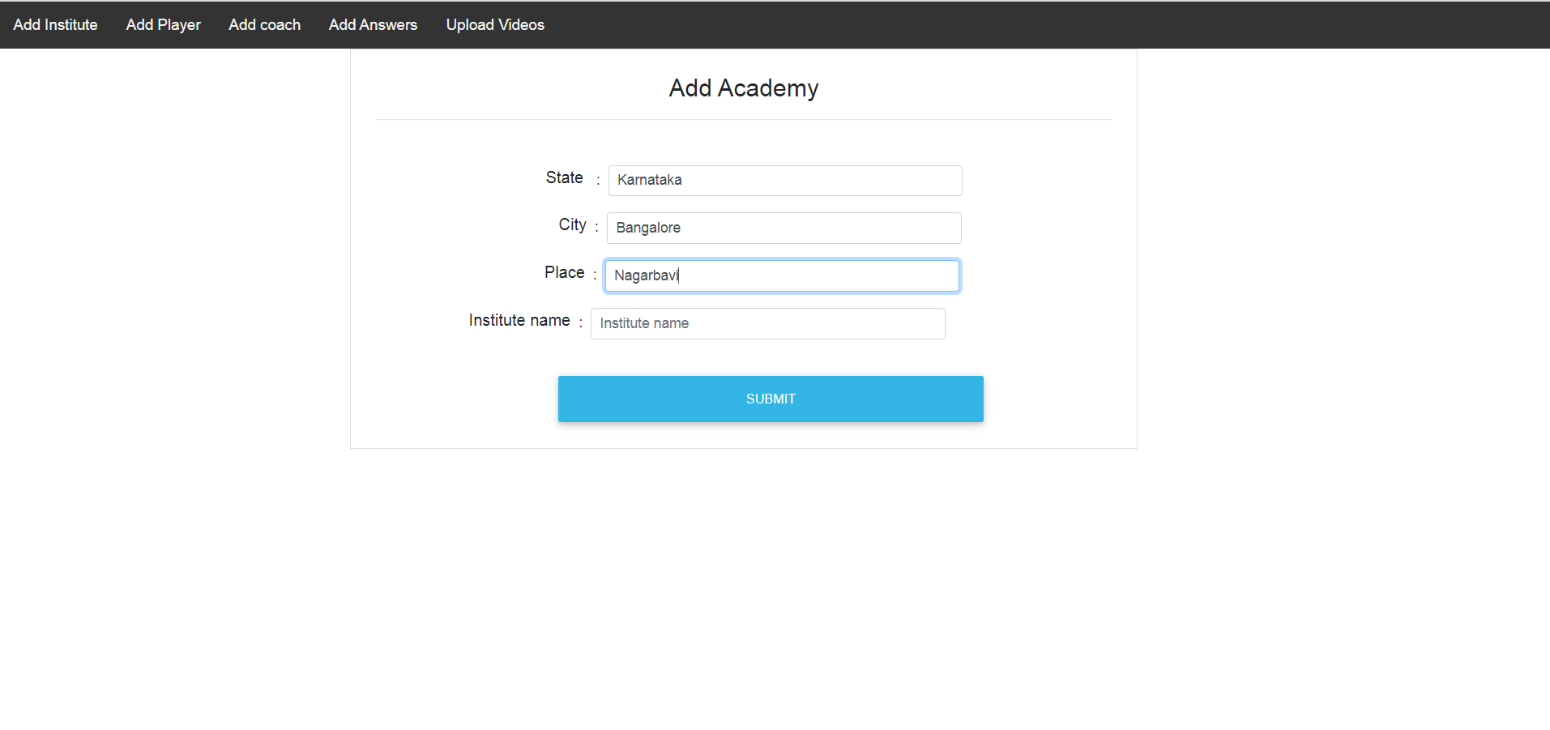
Enter the location.

Slide 12
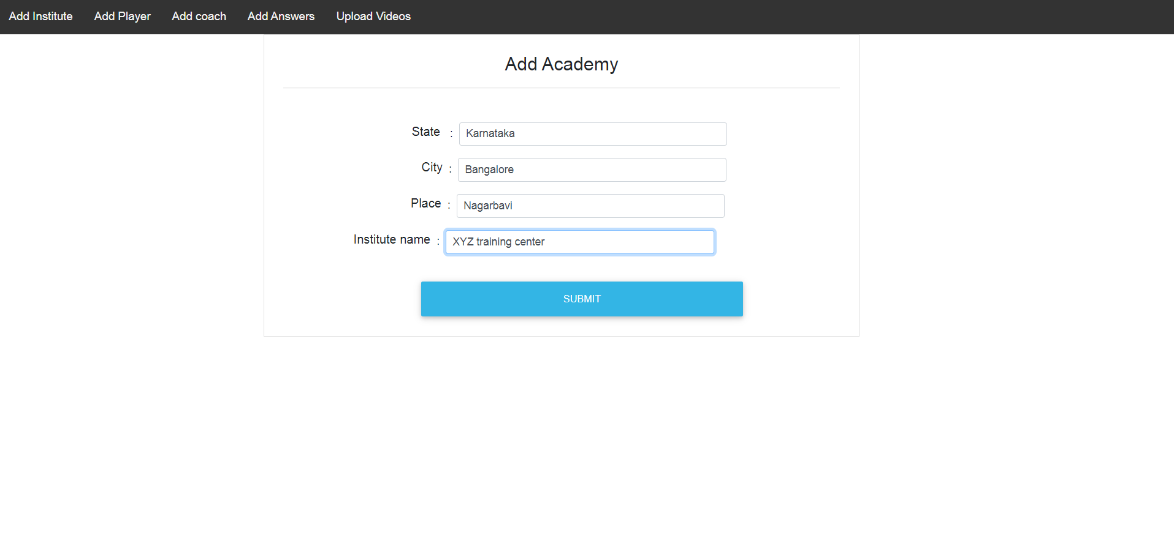
Enter the institute name.

Slide 13
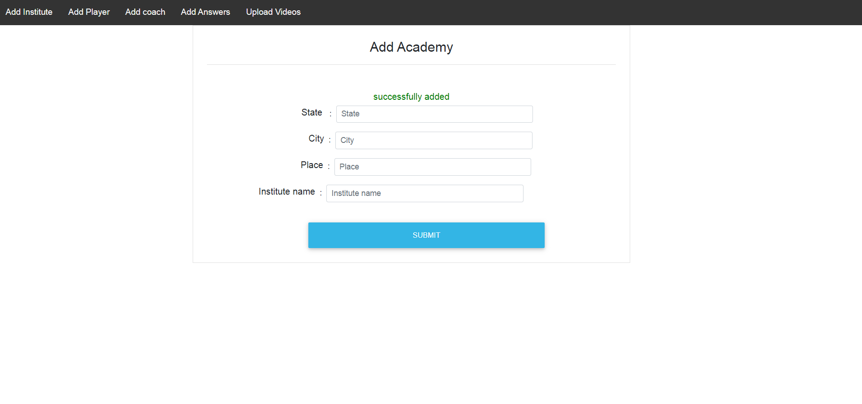
The institute added successfully on to the server.

Slide 14
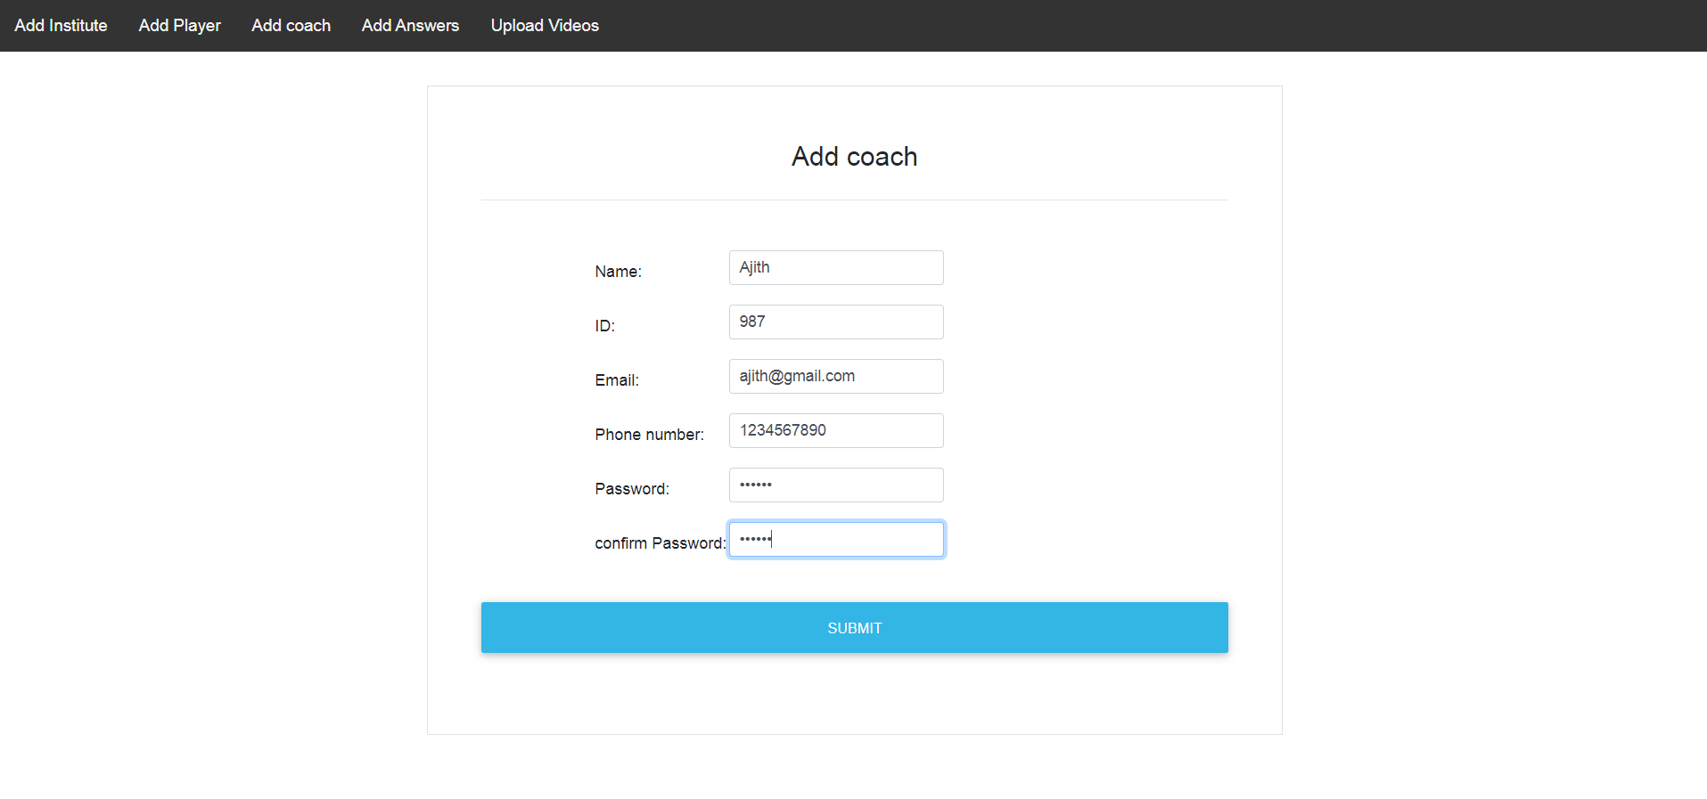
On Clicking the Add coach, admin can add new coach, which is also coach registration page. Fill the required fields in the form and submit.

Slide 15
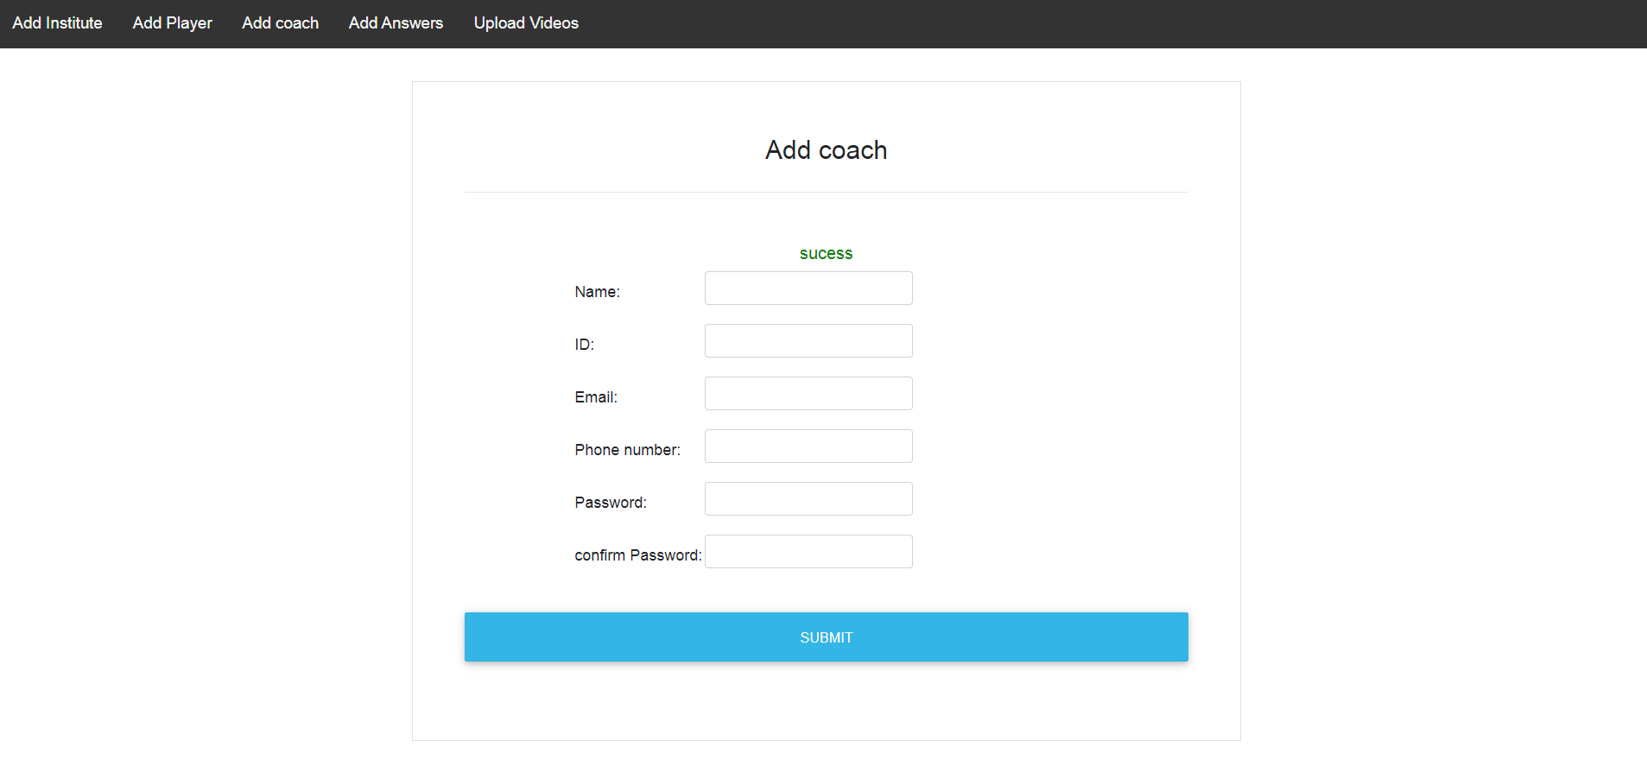
Coach registered successfully

Slide 16
Entering the same details will lead to unsuccessful registration. The ID and Email should be unique from previously added coach information to avoid unsuccessful registration.

Slide 17
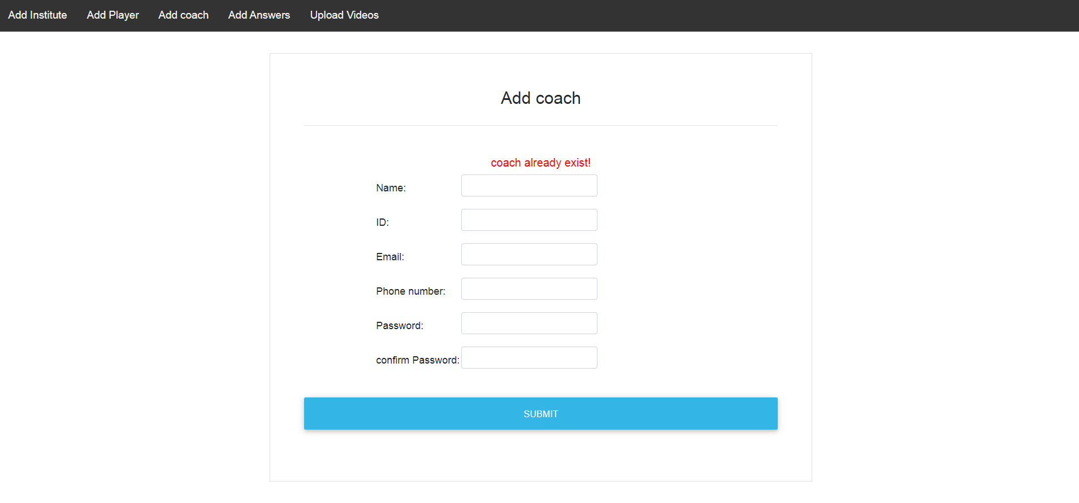
unsuccessful registration when entered the same details.

Slide 18
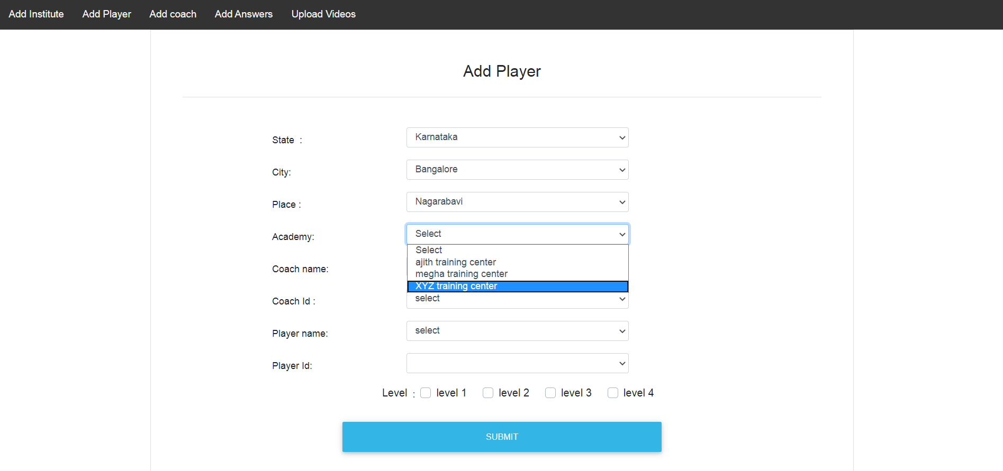
Add Player is the module which maps the player who are registered from android phone to the coach.Enter the required field.

Slide 19
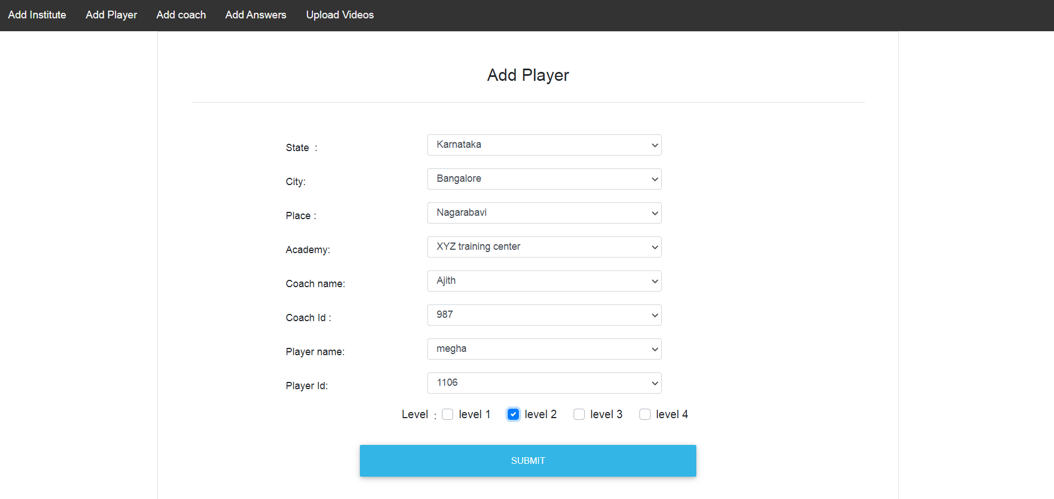
Select coach name, coach Id, player name, player Id and level which is displayed based on the location which is selected from the dropdown.

Slide 20
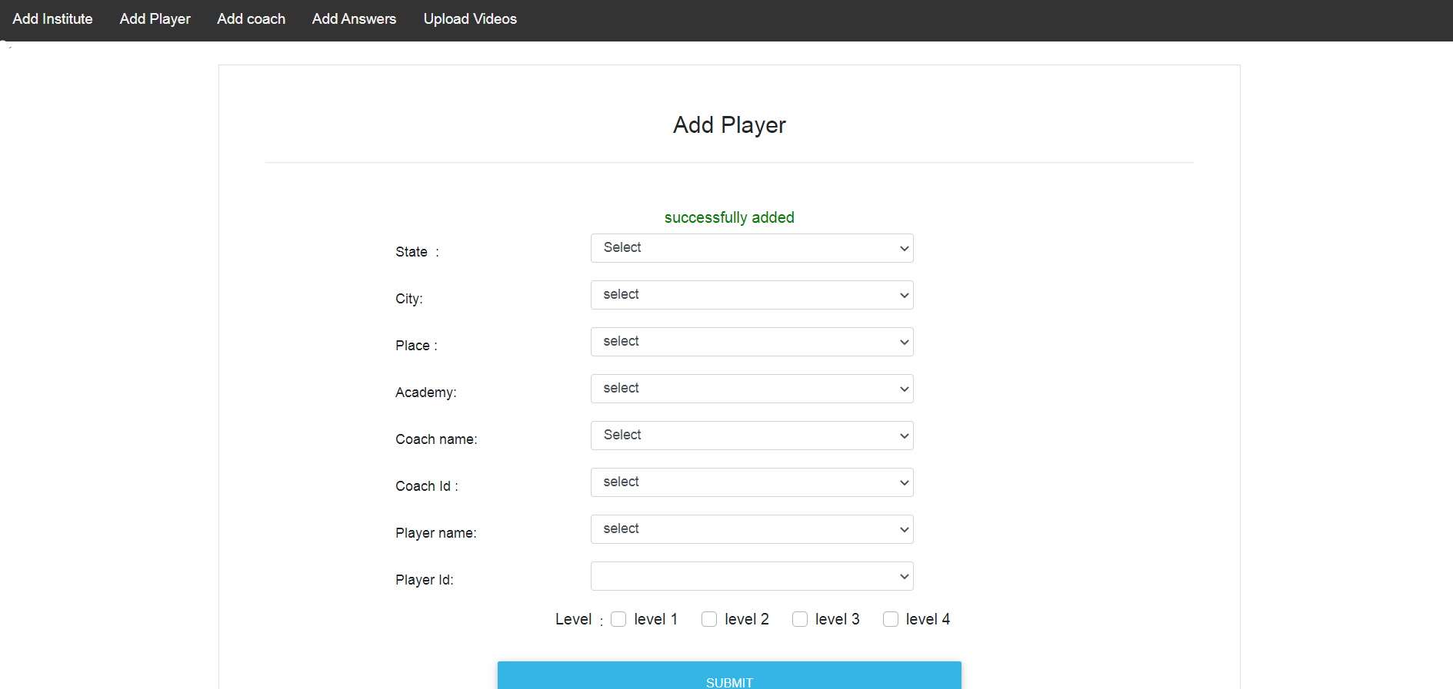
Successful mapping of player and coach.

Slide 21
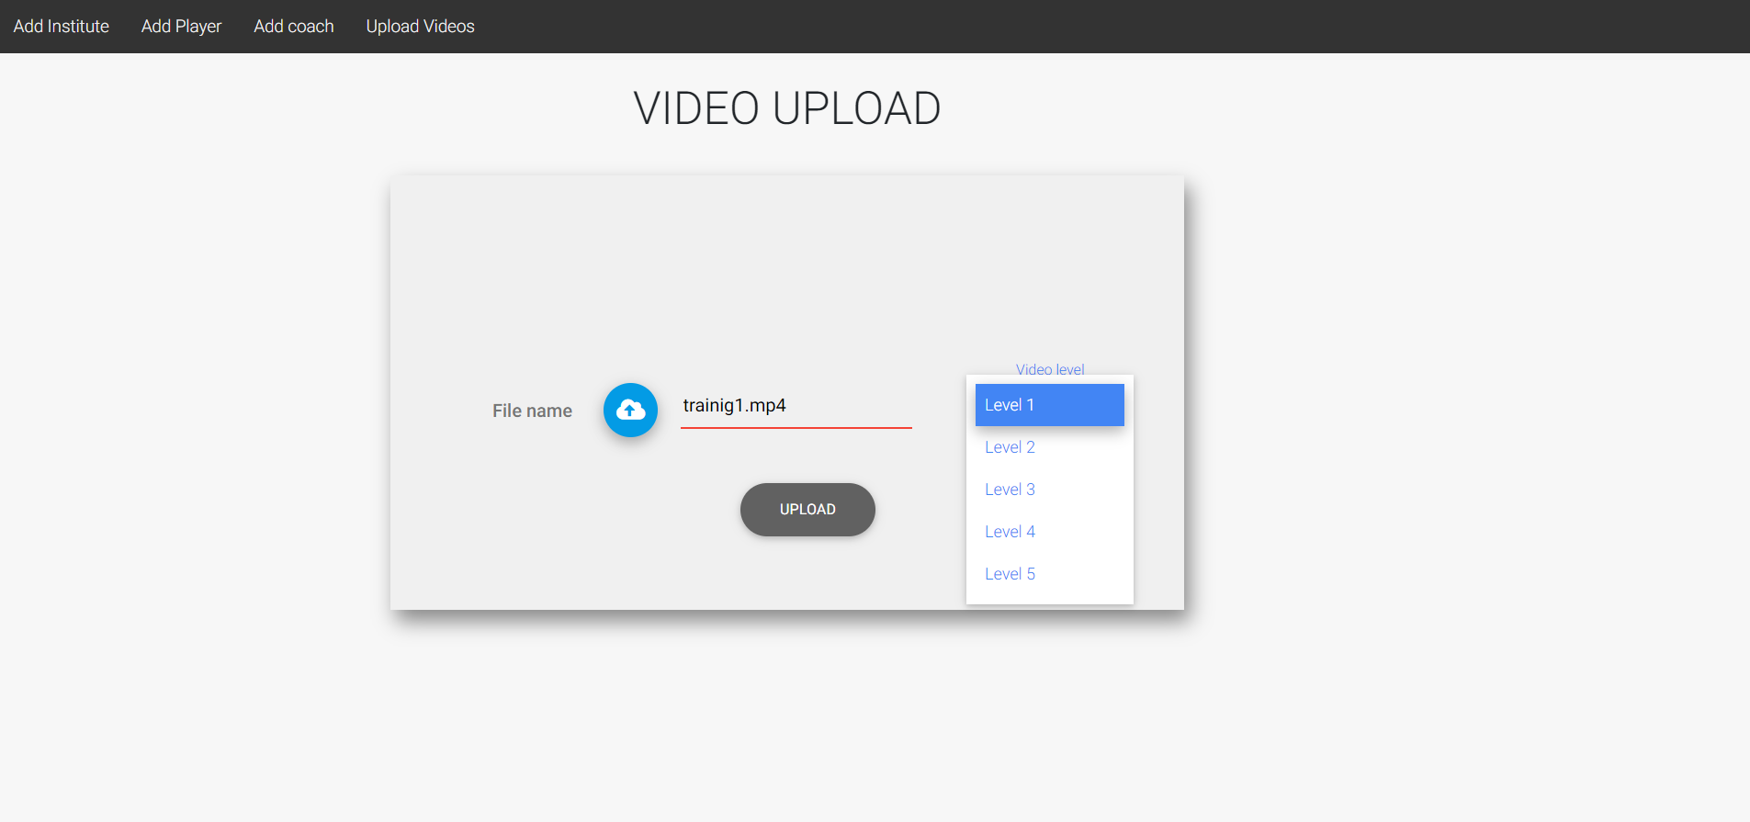
Admin selects different videos from local system and selects different level for the video.

Slide 22
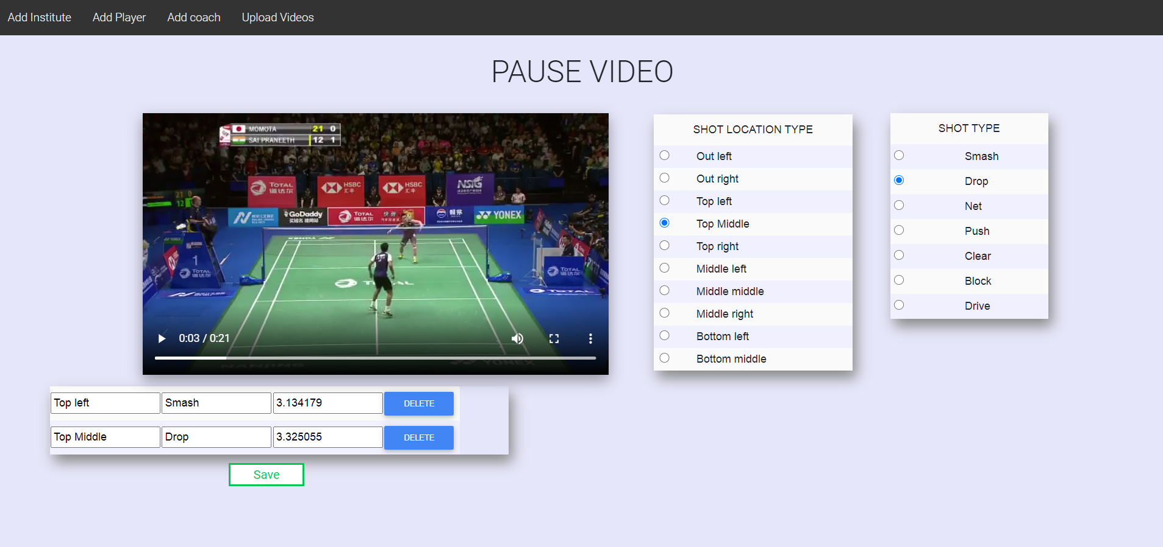
On successful upload of video, redirects to add answers(shot location type and shot type) and
pauses for the uploaded video.

Slide 23
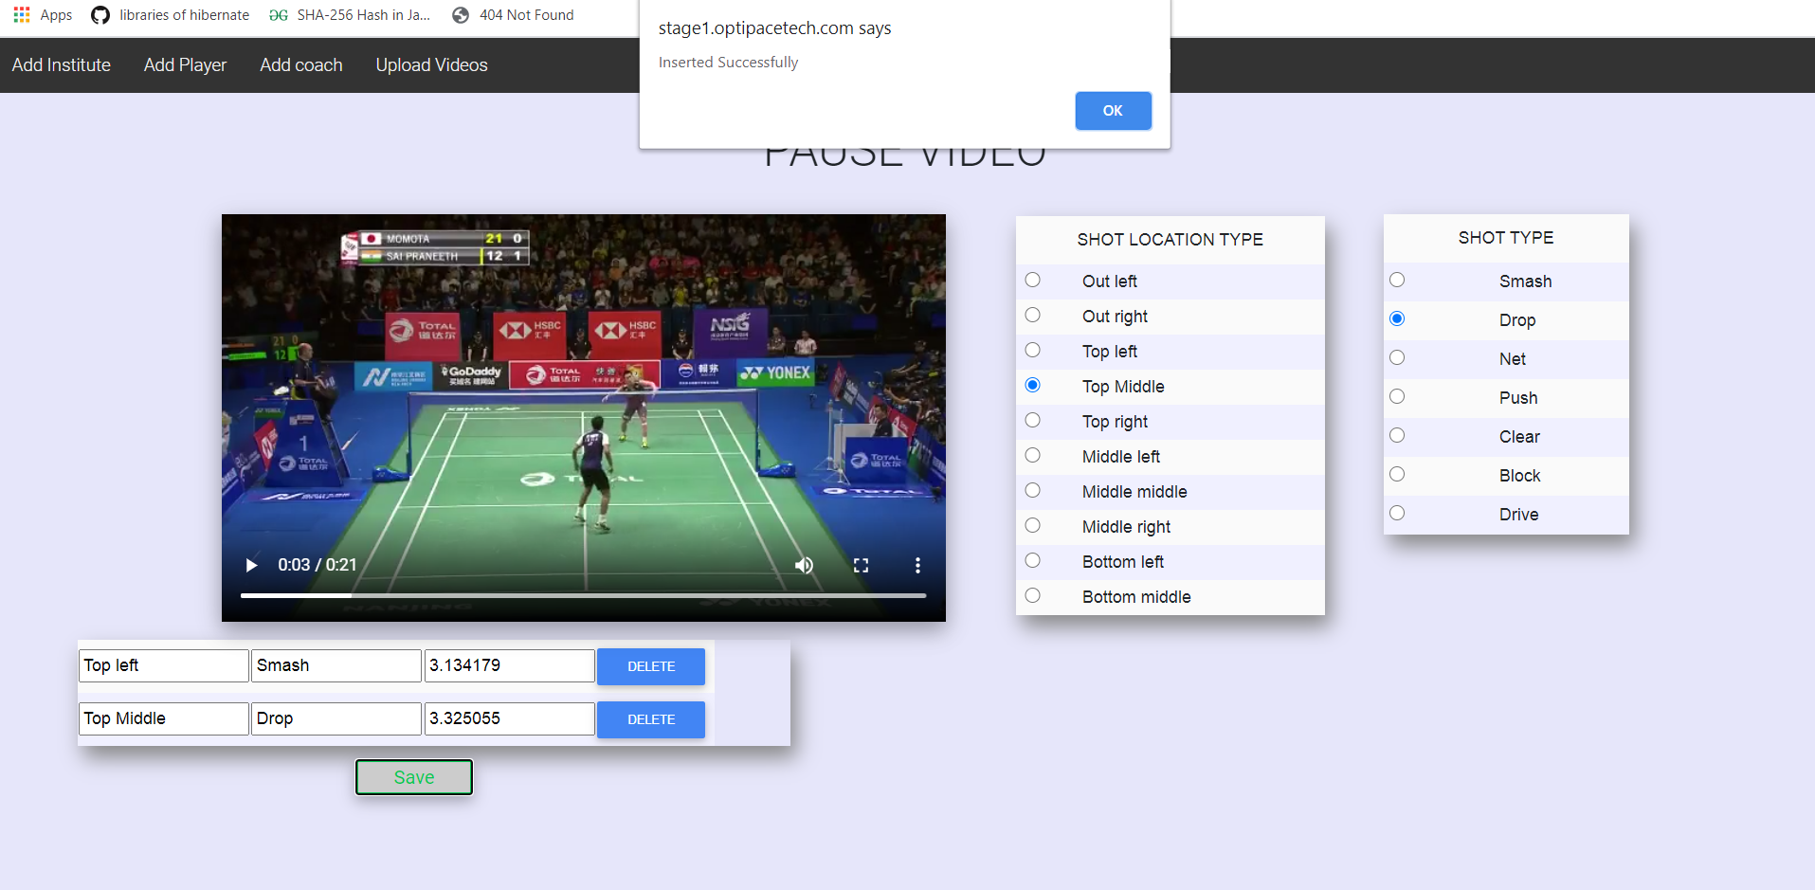
successfully adding the answers by clicking on save button.

